Slide 1
ID2: This time it’s personal
Breaking it down….

Slide 2
Aligning Components
Misalignment between course objectives, activities and assessment can often be the basis of students’ lack of learning. . . researchers have found that lack of excellence in [student learning is] caused, not so much by ineffective teaching, but by misalignment between what instructors intend to teach, what they actually teach, and what they test.
S.A. Cohen, Instructional Alignment: Searching for a Magic Bullet

Slide 4
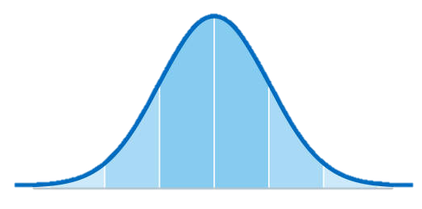
When thinking about comparing groups in a study this is a way to think about effect size. In this case the mean for the treatment group (or aligned group in the study we read) is one standard deviation/ 1-sigma higher than the control (misaligned group).
Treatment Group score distribution
Control Group score distribution

Slide 5
Aptitude = Predicted/Potential
vs
Achievement = Actual/Recorded

Slide 6
What the heck is a 3 x 3 x 2 ANOVA?
Achievement
Aptitude
Allegiance
High
High
Marvel
Mid
Mid
DC
X
X
Low
Low
18 possible combinations

Slide 7
Where do you want them to go?
BIG GOAL (north star)
Break it down more
Break it down more
Break it down more
Discrete Knowledge:
Discrete Skills:
Keep going to you get down to the underlying knowledge and skills/steps

Slide 8
1. Students will design and build an online survey with an authenticated administration module and public presentation module
1A. Designing an appropriate Database Structure to support an application’s needs
1B. Combining control structures to create interfaces
1AA. Tables
1AB. Relationships
1BA. Server Side vs. Client Side
1BB. PHP Syntax
1ABA. LEFT Join two table
Variables
1ABB. LEFT Join 3+ tables
Control Structures
1AC. SQL
Redirection
1ACA. Insert
Delete
Passing / Grabbing Information
Select
Interacting with a database
Update

Slide 9
Goal: Participants will value sleep
Know physiological and cognitive factors of sleep.
Be able to monitor their sleep metrics.
Make behavior changes to improve sleep.
Heart rate
Selecting/Using a monitor
Oxygen saturation
Ring
Using baseline data to target a change
Wrist
Breathing rate
Accessing data on phone
Reviewing trend data to validate trajectory.
Stages of sleep

